Slide 1


Slide 2
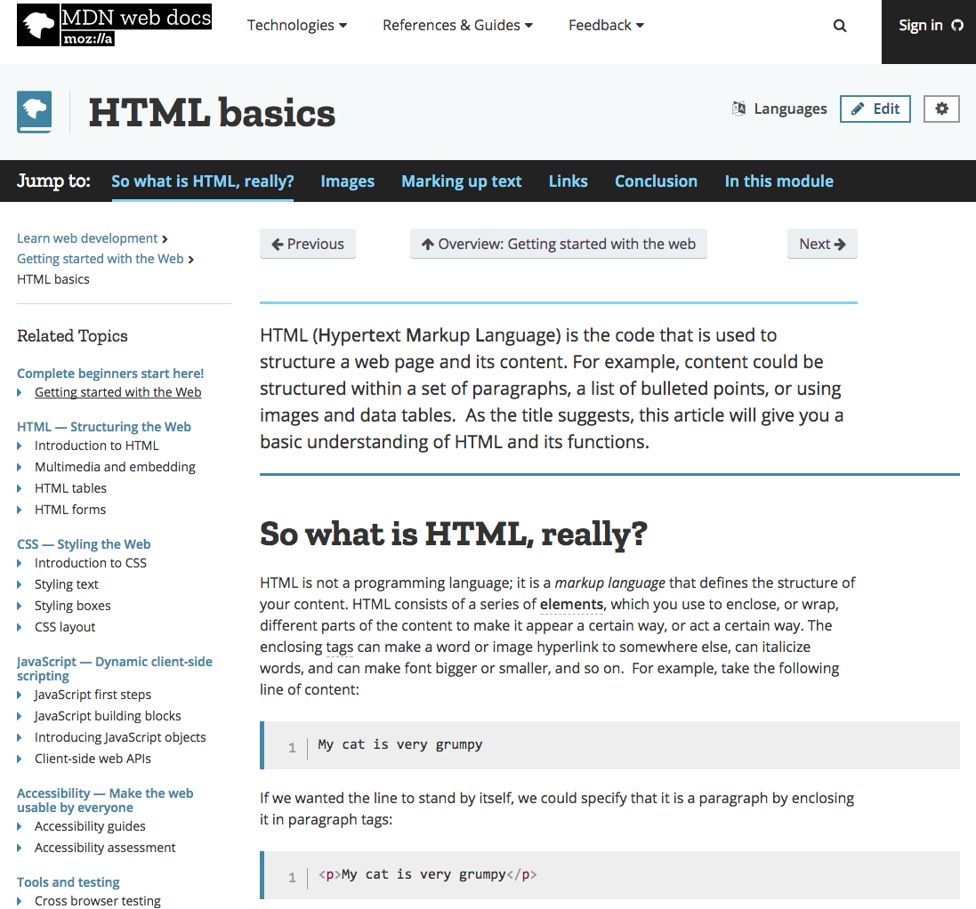
Useful Web Resource: MDN Web Docs
https://developer.mozilla.org/en-US/docs/Learn/Getting_started_with_the_web/HTML_basics

Slide 3


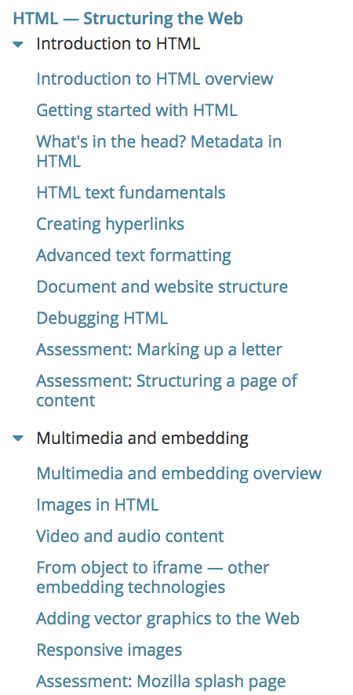
HTML: Structuring the Web

Slide 4
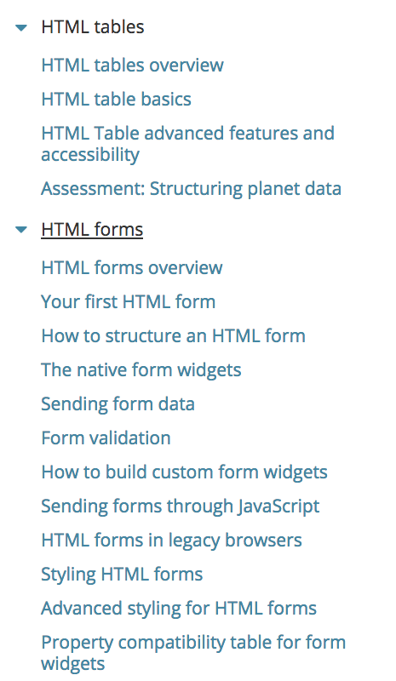
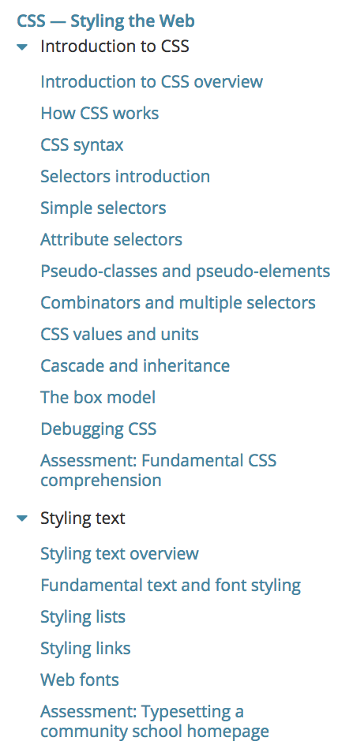
HTML: Structuring the Web

Slide 5
CSS: Styling the Web

Slide 6
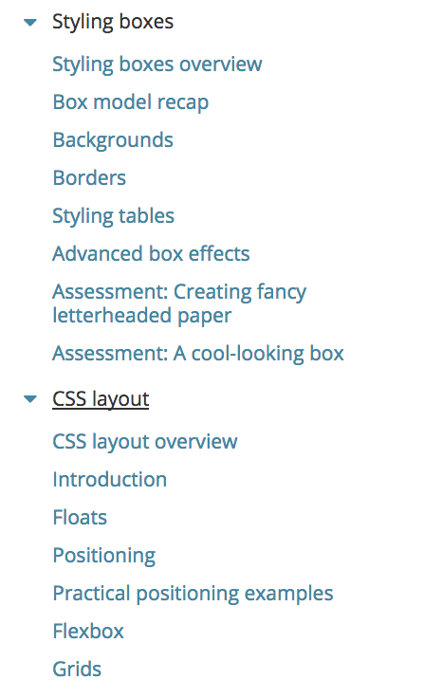
CSS: Styling the Web

Slide 7

Useful Text
Head First HTML and CSS, 2nd Edition. By Freeman, Elisabeth and Eric Freeman. 2012. Head First HTML with CSS & XHTML . O'Reilly & Associates. 658 p. ISBN 978-0-596-15990-0

Slide 8
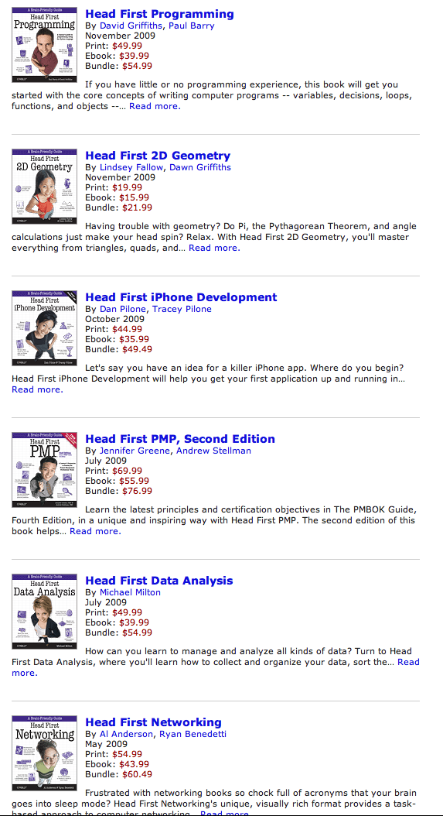
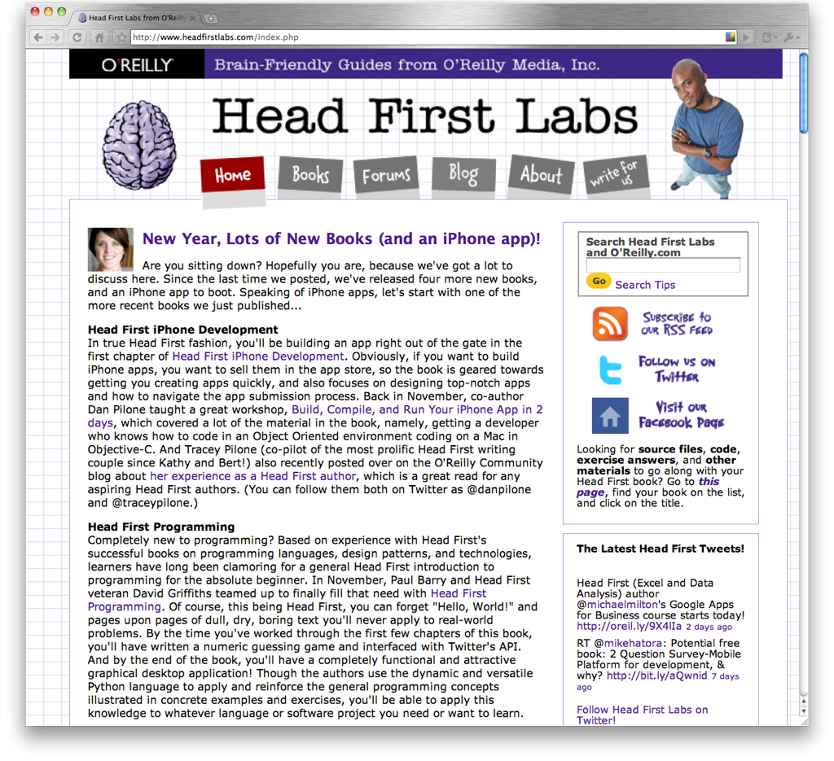

Slide 9
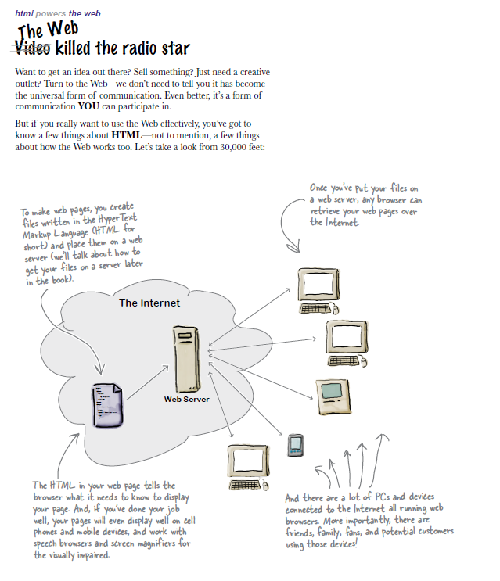
A flavour of the book…

Slide 10
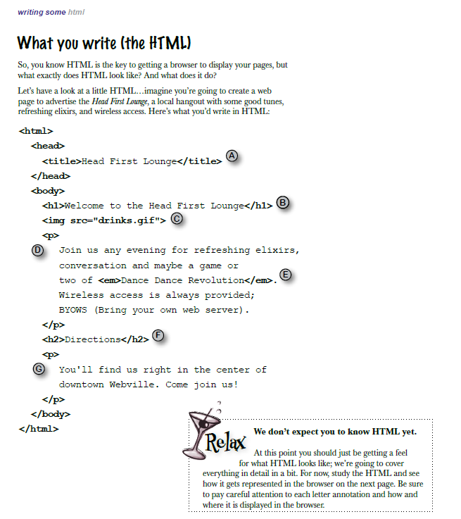
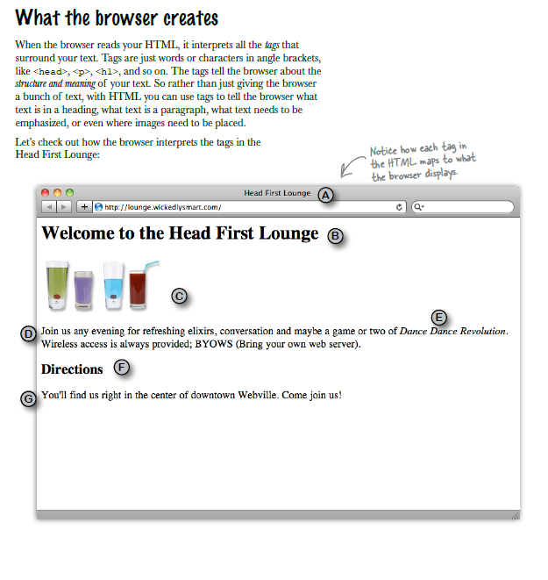
A flavour of the book…

Slide 11

Another Useful Text
HTML and CSS: Design and Build Websites. By Jon Duckett. 2011. John Wiley & Sons; 01 edition (18 Nov. 2011), 512 pages, ISBN-10: 1118008189

Slide 12


A flavour of the book…

Slide 13
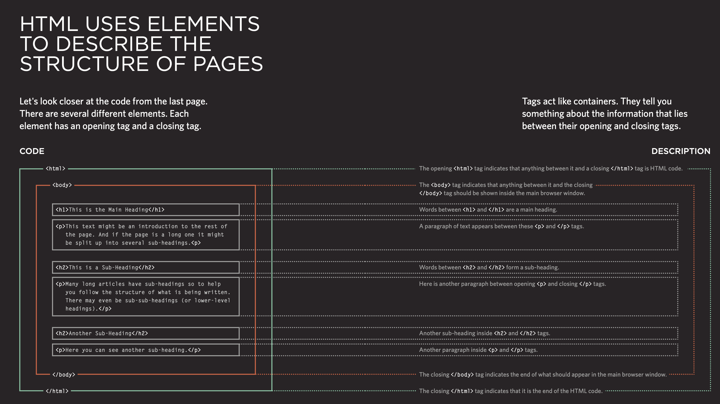

Slide 14
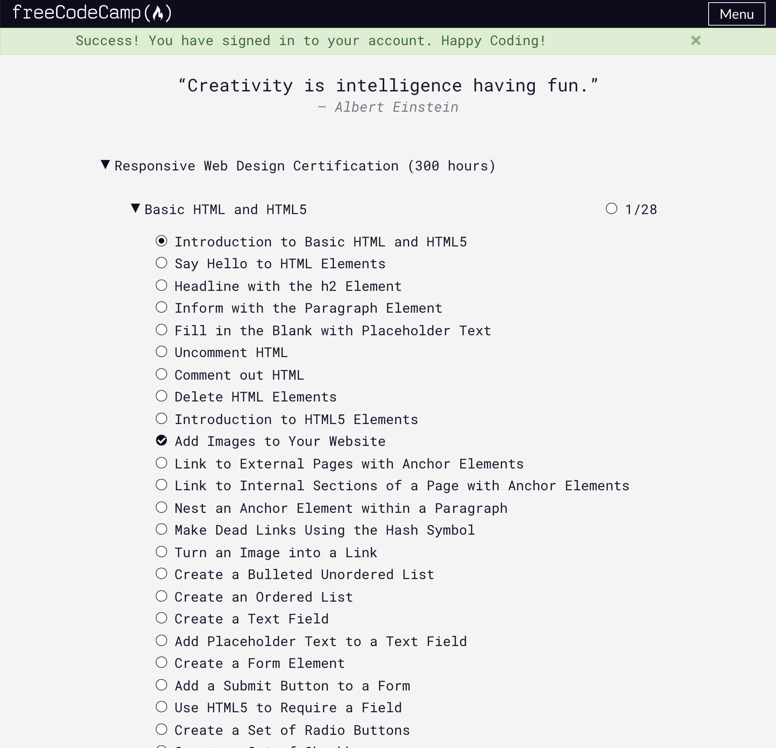

Free Code Camp
https://www.freecodecamp.org
Sing with your GitHub account

Slide 15
